Slide 1


Global Wealth & Asset Management
Highlight Application Assessments – SCA and Cloud Results
{month} {year}
Software Intelligence for Digital Leaders

Slide 2





CAST Highlight Core Capabilities
Software Health
Resiliency & Agility
Cloud Readiness
Roadblocks & Boosters
Software Composition
OSS Vulnerabilities & IP Risks
Private Data Detection
GDPR & PII Patterns
Application Portfolio Analysis
SaaS – Simple to Use – Cost Effective – Non-Intrusive

Slide 3

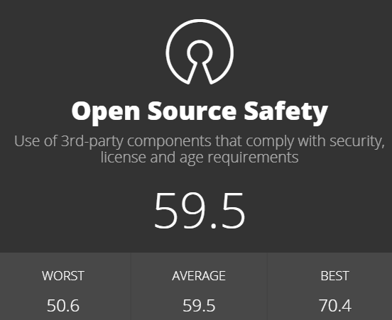
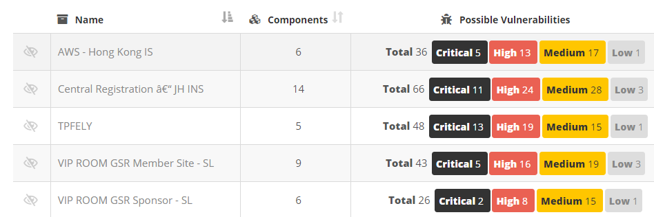
What Makes CAST Highlight SCA Unique?
Actionable Technology Insights with Business Context
Code scan data + Qualitative survey information
Utilize Business Impact for more informed decision-making and prioritization of open-source risks
Open-Source Safety measure aggregates vulnerability, license, and obsolescence risk into one score
Instant Visibility Deployed Simply
Lightweight SaaS platform
Onboard 100s of apps in a week
Source code never leaves premises

Slide 4

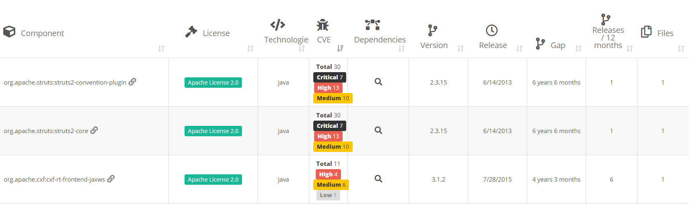
Software Composition At A Glance
Open source is one of the major entry points for hackers. Highlight continuously identifies if the third-party components you’re using contain security vulnerabilities
As your development teams are not legal experts, Highlight provides visibility on the licenses used to detect any restrictive license compliance associated with your OS components
For both functional and security reasons, it’s important that your third-party components are always up to date. Highlight instantly detects which applications use obsolete component versions that require upgrades.

Slide 5
Software Intelligence for Digital Leaders
Executive Summary
Assessment Scope, Objectives, Findings & Recommendations

Slide 6
Assessment Scope, Objectives, Findings & Recommendations
Assessment Scope: Five top "distributed" applications by code volume
{all_application_names}
Objective | Finding | Recommendations
Check Third-Party Vulnerabilities Discover & remove outdated & vulnerable software components | {crit_cve_tot_all_apps} critical and {high_cve_tot_all_apps} high vulnerabilities found across these {appl_count} applications. | Latest version of most components have fixes for these issues – see Highlight for more information. Review firewall and security wrappers for vulnerable components.
Control Open Source License Compliance Identify & Quantify Unauthorized OSS Components in Portfolio | {high_lic_tot_all_apps} uses of open source license that could require these applications to share proprietary code. | Ensure compliance to open-source component license and get specialized legal advice for IP protection if necessary.
Reduce Technology Obsolescence Identify & Quantify obsolete OSS Components in Portfolio | 229 open source components have not been updated in over five years. 45 components have not been updated in over 10 years. | Update obsolete components. Establish a process to review open-source components for license risks, security vulnerabilities and obsolescence.

Slide 7



CWE-20: Improper Input Validation
https://cwe.mitre.org/data/definitions/20.html
Input validation is the proper testing of any input supplied by a user or application. Input validation prevents improperly formed data, including malicious code from entering a system.
Impact of CWE-20
CWE-20 caused the Equifax Data Breach, 2017 https://republicans-oversight.house.gov/wp-content/uploads/2018/12/Equifax-Report.pdf
March 7 – Apache released a patch for the CVE-2017-5638 vulnerability (CWE-20)
March 15 – Equifax’s Security team ran scans and did not detect the vulnerability on any externally facing systems.
March 10 to July 30 – Attackers entered the Equifax network through the Apache Struts vulnerability located within the Automated Consumer Interview System (ACIS) application on May 13. Equifax’s Security team observed suspicious activity and shut down the attack on July 30. There is evidence of attackers exploiting the vulnerability on servers connected to Equifax network as early as March 10.
Denial-of-service (DoS) attack
Cause the application to Crash, Exit, or Restart
Consume host memory and/or CPU
Expose confidential data
Modify Memory
Execute Unauthorized Code or Commands
Modify data or possibly alter control flow in unexpected ways

Slide 8

CWE-284: Improper Access Control
https://cwe.mitre.org/data/definitions/284.html
The web application does not, or can not, sufficiently verify whether a well-formed, valid, consistent request was intentionally provided by the user who submitted the request.
Impact of CWE-284
CWE-284 led to unauthorized access to PHI data at DoD hospitals and clinics https://media.defense.gov/2018/May/07/2001913398/-1/-1/1/DODIG-2018-109.PDF
Software at U.S Navy and Air Force hospitals and did not effectively implement security protocols, allowing hackers to access networks without using multifactor authentication, and allowed unauthorized access to PHI data. The Inspector General of the Department of Defense published a report in May 2018 with detailed findings. The report made 17 recommendations impacting 5 facilities and multiple health systems within the USAF and Navy.
Availability - Denial-of-service (DoS) attack
Cause the application to Crash, Exit, or Restart
Consume host memory and/or CPU
Confidentiality - Gain privileges or assume identity
Integrity - Bypass protection mechanism
Other - Varies by context

Slide 9

{app1_name} - IP Risk Assessment from Open-Source Software (OSS) Analysis
License Compliance Risks
License Name | Risk Factor | Comp Count | Top 5 Latest Components
xxxxxxxxxxxxxxxxxxxxxxxxx | xxxxxxxxxxxxxx | #,### | xxxxxxxxxxxxxxxxxxxxxxxxxxxxxxxxxx
xxxxxxxxxxxxxxxxxxxxxxxxx | xxxxxxxxxxxxxx | #,### | xxxxxxxxxxxxxxxxxxxxxxxxxxxxxxxxxx
xxxxxxxxxxxxxxxxxxxxxxxxx | xxxxxxxxxxxxxx | #,### | xxxxxxxxxxxxxxxxxxxxxxxxxxxxxxxxxx
xxxxxxxxxxxxxxxxxxxxxxxxx | xxxxxxxxxxxxxx | #,### | xxxxxxxxxxxxxxxxxxxxxxxxxxxxxxxxxx
xxxxxxxxxxxxxxxxxxxxxxxxx | xxxxxxxxxxxxxx | #,### | xxxxxxxxxxxxxxxxxxxxxxxxxxxxxxxxxx
xxxxxxxxxxxxxxxxxxxxxxxxx | xxxxxxxxxxxxxx | #,### | xxxxxxxxxxxxxxxxxxxxxxxxxxxxxxxxxx
xxxxxxxxxxxxxxxxxxxxxxxxx | xxxxxxxxxxxxxx | #,### | xxxxxxxxxxxxxxxxxxxxxxxxxxxxxxxxxx
xxxxxxxxxxxxxxxxxxxxxxxxx | xxxxxxxxxxxxxx | #,### | xxxxxxxxxxxxxxxxxxxxxxxxxxxxxxxxxx
xxxxxxxxxxxxxxxxxxxxxxxxx | xxxxxxxxxxxxxx | #,### | xxxxxxxxxxxxxxxxxxxxxxxxxxxxxxxxxx
xxxxxxxxxxxxxxxxxxxxxxxxx | xxxxxxxxxxxxxx | #,### | xxxxxxxxxxxxxxxxxxxxxxxxxxxxxxxxxx
xxxxxxxxxxxxxxxxxxxxxxxxx | xxxxxxxxxxxxxx | #,### | xxxxxxxxxxxxxxxxxxxxxxxxxxxxxxxxxx
xxxxxxxxxxxxxxxxxxxxxxxxx | xxxxxxxxxxxxxx | #,### | xxxxxxxxxxxxxxxxxxxxxxxxxxxxxxxxxx
xxxxxxxxxxxxxxxxxxxxxxxxx | xxxxxxxxxxxxxx | #,### | xxxxxxxxxxxxxxxxxxxxxxxxxxxxxxxxxx
xxxxxxxxxxxxxxxxxxxxxxxxx | xxxxxxxxxxxxxx | #,### | xxxxxxxxxxxxxxxxxxxxxxxxxxxxxxxxxx
xxxxxxxxxxxxxxxxxxxxxxxxx | xxxxxxxxxxxxxx | #,### | xxxxxxxxxxxxxxxxxxxxxxxxxxxxxxxxxx
xxxxxxxxxxxxxxxxxxxxxxxxx | xxxxxxxxxxxxxx | #,### | xxxxxxxxxxxxxxxxxxxxxxxxxxxxxxxxxx
xxxxxxxxxxxxxxxxxxxxxxxxx | xxxxxxxxxxxxxx | #,### | xxxxxxxxxxxxxxxxxxxxxxxxxxxxxxxxxx
xxxxxxxxxxxxxxxxxxxxxxxxx | xxxxxxxxxxxxxx | #,### | xxxxxxxxxxxxxxxxxxxxxxxxxxxxxxxxxx
xxxxxxxxxxxxxxxxxxxxxxxxx | xxxxxxxxxxxxxx | #,### | xxxxxxxxxxxxxxxxxxxxxxxxxxxxxxxxxx
xxxxxxxxxxxxxxxxxxxxxxxxx | xxxxxxxxxxxxxx | #,### | xxxxxxxxxxxxxxxxxxxxxxxxxxxxxxxxxx
xxxxxxxxxxxxxxxxxxxxxxxxx | xxxxxxxxxxxxxx | #,### | xxxxxxxxxxxxxxxxxxxxxxxxxxxxxxxxxx
{app1_high_lic_tot} direct license risks identified out of {app1_oss_cmpn_tot} open-source components detected.
{app1_crit_cve_comp_ct} components with {app1_crit_sec_tot} unique critical security vulnerability identified, {app1_high_cve_comp_ct} components with {app1_high_sec_tot} High and {app1_med_cve_comp_ct} components with {app1_med_sec_tot} Medium criticality CVEs detected.
Recommend addressing the vulnerabilities by avoiding usage, implementing appropriate firewall rules or upgrading the component to a safer version, as applicable.
Bill Of Materials for {app1_name} (Double-click to open)
{app_per_page}

Slide 10
{project} Open-source component obsolescence
Explanation
Total components detected: {app1_oss_cmpn_tot}
Components that are at least 5 years old: XX%
XX% of the components have not had a release in the last 5 years.
Recommend upgrading components older than 5 years, where more recent release is available.
Refer to the attached Excel spreadsheet for details.
{app1_name} - Obsolescence report
(Double-click to open)
This chart shows the number of components with large gaps between the version currently used and the latest available version.
{app_per_page}

Slide 11
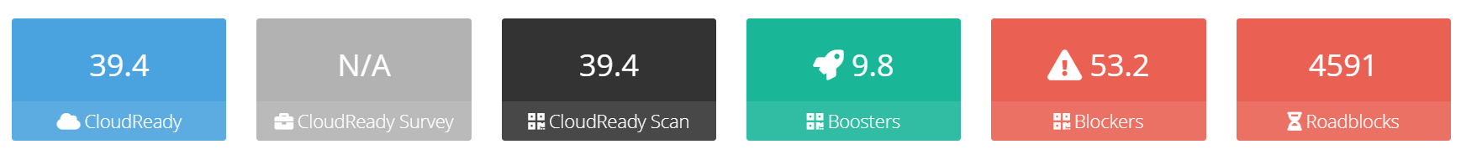
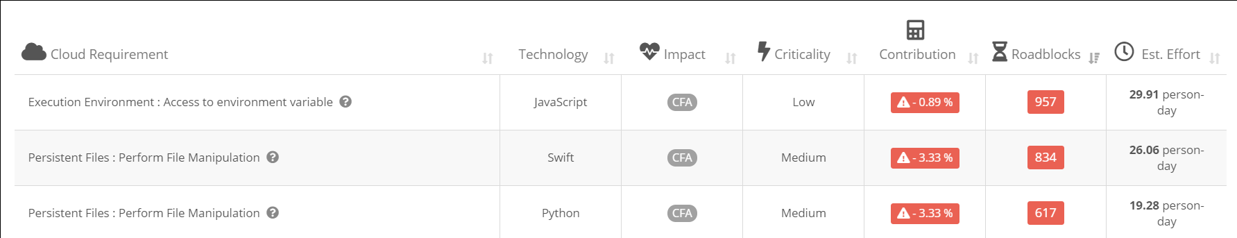
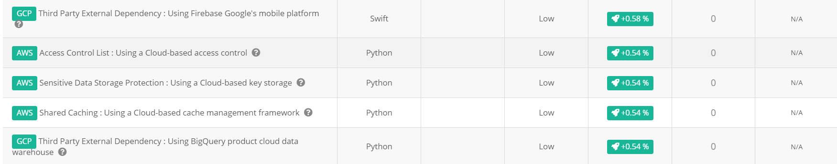
{app1_name} Assessment for cloud compliance [PaaS]
Cloud Migration Blockers
Sample Image
Cloud Migration Boosters
{app_per_page}

Slide 12
{cwe-id}: Findings & Recommendation
Findings
Found {crit-cves} critical vulnerabilities and exposures (CVE) related to use of {cmpnt-tot} components in {crit-appls} applications ({app-list}).
Recommendations
{group:component}{component_name} is in use by {component_app_use} applications ({component_app_list}), containing {component_crit_cve} critical vulnerability. The version in use, {current_version} was released in {current_version_release_date}, the latest version {latest_version} released on {latest_version_release_date} contains no known vulnerabilities.{/group:component}
{cmpnt-list}

Slide 13

{cwe-id}: CVE Details
Component | Common Vulnerability and Exposure (CVE) | app1 | app1 | app1 | app1 | app1 | app1 | app1 | app1
xxxxxxxxxxxxxxxxxxxxxxxxx | xxxxxxxxxxxxxxxxxxxxxxxxxxxxxxxxxxxxxxxxxxxxxxxxxxxxxxxxxxxxxxxxxxxxxxxxxxxxxxxxxxxxxxxxxxxxxxxxxxxxxxxxxxxxxxxxxxxxxxxxxxxxxxxxxxxxxxxxxxxxxxxxxxxxxxxxxxxxxxxxxxxxxxxxxxxxxxxxxxxxxxxxxxxxxx
xxxxxxxxxxxxxxxxxxxxxxxxx | xxxxxxxxxxxxxxxxxxxxxxxxxxxxxxxxxxxxxxxxxxxxxxxxxxxxxxxxxxxxxxxxxxxxxxxxxxxxxxxxxxxxxxxxxxxxxxxxxxxxxxxxxxxxxxxxxxxxxxxxxxxxxxxxxxxxxxxxxxxxxxxxxxxxxxxxxxxxxxxxxxxxxxxxxxxxxxxxxxxxxxxxxxxxxx
xxxxxxxxxxxxxxxxxxxxxxxxx | xxxxxxxxxxxxxxxxxxxxxxxxxxxxxxxxxxxxxxxxxxxxxxxxxxxxxxxxxxxxxxxxxxxxxxxxxxxxxxxxxxxxxxxxxxxxxxxxxxxxxxxxxxxxxxxxxxxxxxxxxxxxxxxxxxxxxxxxxxxxxxxxxxxxxxxxxxxxxxxxxxxxxxxxxxxxxxxxxxxxxxxxxxxxxx
xxxxxxxxxxxxxxxxxxxxxxxxx | xxxxxxxxxxxxxxxxxxxxxxxxxxxxxxxxxxxxxxxxxxxxxxxxxxxxxxxxxxxxxxxxxxxxxxxxxxxxxxxxxxxxxxxxxxxxxxxxxxxxxxxxxxxxxxxxxxxxxxxxxxxxxxxxxxxxxxxxxxxxxxxxxxxxxxxxxxxxxxxxxxxxxxxxxxxxxxxxxxxxxxxxxxxxxx
xxxxxxxxxxxxxxxxxxxxxxxxx | xxxxxxxxxxxxxxxxxxxxxxxxxxxxxxxxxxxxxxxxxxxxxxxxxxxxxxxxxxxxxxxxxxxxxxxxxxxxxxxxxxxxxxxxxxxxxxxxxxxxxxxxxxxxxxxxxxxxxxxxxxxxxxxxxxxxxxxxxxxxxxxxxxxxxxxxxxxxxxxxxxxxxxxxxxxxxxxxxxxxxxxxxxxxxx
xxxxxxxxxxxxxxxxxxxxxxxxx | xxxxxxxxxxxxxxxxxxxxxxxxxxxxxxxxxxxxxxxxxxxxxxxxxxxxxxxxxxxxxxxxxxxxxxxxxxxxxxxxxxxxxxxxxxxxxxxxxxxxxxxxxxxxxxxxxxxxxxxxxxxxxxxxxxxxxxxxxxxxxxxxxxxxxxxxxxxxxxxxxxxxxxxxxxxxxxxxxxxxxxxxxxxxxx
xxxxxxxxxxxxxxxxxxxxxxxxx | xxxxxxxxxxxxxxxxxxxxxxxxxxxxxxxxxxxxxxxxxxxxxxxxxxxxxxxxxxxxxxxxxxxxxxxxxxxxxxxxxxxxxxxxxxxxxxxxxxxxxxxxxxxxxxxxxxxxxxxxxxxxxxxxxxxxxxxxxxxxxxxxxxxxxxxxxxxxxxxxxxxxxxxxxxxxxxxxxxxxxxxxxxxxxx
xxxxxxxxxxxxxxxxxxxxxxxxx | xxxxxxxxxxxxxxxxxxxxxxxxxxxxxxxxxxxxxxxxxxxxxxxxxxxxxxxxxxxxxxxxxxxxxxxxxxxxxxxxxxxxxxxxxxxxxxxxxxxxxxxxxxxxxxxxxxxxxxxxxxxxxxxxxxxxxxxxxxxxxxxxxxxxxxxxxxxxxxxxxxxxxxxxxxxxxxxxxxxxxxxxxxxxxx
xxxxxxxxxxxxxxxxxxxxxxxxx | xxxxxxxxxxxxxxxxxxxxxxxxxxxxxxxxxxxxxxxxxxxxxxxxxxxxxxxxxxxxxxxxxxxxxxxxxxxxxxxxxxxxxxxxxxxxxxxxxxxxxxxxxxxxxxxxxxxxxxxxxxxxxxxxxxxxxxxxxxxxxxxxxxxxxxxxxxxxxxxxxxxxxxxxxxxxxxxxxxxxxxxxxxxxxx
xxxxxxxxxxxxxxxxxxxxxxxxx | xxxxxxxxxxxxxxxxxxxxxxxxxxxxxxxxxxxxxxxxxxxxxxxxxxxxxxxxxxxxxxxxxxxxxxxxxxxxxxxxxxxxxxxxxxxxxxxxxxxxxxxxxxxxxxxxxxxxxxxxxxxxxxxxxxxxxxxxxxxxxxxxxxxxxxxxxxxxxxxxxxxxxxxxxxxxxxxxxxxxxxxxxxxxxx
xxxxxxxxxxxxxxxxxxxxxxxxx | xxxxxxxxxxxxxxxxxxxxxxxxxxxxxxxxxxxxxxxxxxxxxxxxxxxxxxxxxxxxxxxxxxxxxxxxxxxxxxxxxxxxxxxxxxxxxxxxxxxxxxxxxxxxxxxxxxxxxxxxxxxxxxxxxxxxxxxxxxxxxxxxxxxxxxxxxxxxxxxxxxxxxxxxxxxxxxxxxxxxxxxxxxxxxx
xxxxxxxxxxxxxxxxxxxxxxxxx | xxxxxxxxxxxxxxxxxxxxxxxxxxxxxxxxxxxxxxxxxxxxxxxxxxxxxxxxxxxxxxxxxxxxxxxxxxxxxxxxxxxxxxxxxxxxxxxxxxxxxxxxxxxxxxxxxxxxxxxxxxxxxxxxxxxxxxxxxxxxxxxxxxxxxxxxxxxxxxxxxxxxxxxxxxxxxxxxxxxxxxxxxxxxxx
xxxxxxxxxxxxxxxxxxxxxxxxx | xxxxxxxxxxxxxxxxxxxxxxxxxxxxxxxxxxxxxxxxxxxxxxxxxxxxxxxxxxxxxxxxxxxxxxxxxxxxxxxxxxxxxxxxxxxxxxxxxxxxxxxxxxxxxxxxxxxxxxxxxxxxxxxxxxxxxxxxxxxxxxxxxxxxxxxxxxxxxxxxxxxxxxxxxxxxxxxxxxxxxxxxxxxxxx
xxxxxxxxxxxxxxxxxxxxxxxxx | xxxxxxxxxxxxxxxxxxxxxxxxxxxxxxxxxxxxxxxxxxxxxxxxxxxxxxxxxxxxxxxxxxxxxxxxxxxxxxxxxxxxxxxxxxxxxxxxxxxxxxxxxxxxxxxxxxxxxxxxxxxxxxxxxxxxxxxxxxxxxxxxxxxxxxxxxxxxxxxxxxxxxxxxxxxxxxxxxxxxxxxxxxxxxx
xxxxxxxxxxxxxxxxxxxxxxxxx | xxxxxxxxxxxxxxxxxxxxxxxxxxxxxxxxxxxxxxxxxxxxxxxxxxxxxxxxxxxxxxxxxxxxxxxxxxxxxxxxxxxxxxxxxxxxxxxxxxxxxxxxxxxxxxxxxxxxxxxxxxxxxxxxxxxxxxxxxxxxxxxxxxxxxxxxxxxxxxxxxxxxxxxxxxxxxxxxxxxxxxxxxxxxxx
xxxxxxxxxxxxxxxxxxxxxxxxx | xxxxxxxxxxxxxxxxxxxxxxxxxxxxxxxxxxxxxxxxxxxxxxxxxxxxxxxxxxxxxxxxxxxxxxxxxxxxxxxxxxxxxxxxxxxxxxxxxxxxxxxxxxxxxxxxxxxxxxxxxxxxxxxxxxxxxxxxxxxxxxxxxxxxxxxxxxxxxxxxxxxxxxxxxxxxxxxxxxxxxxxxxxxxxx
xxxxxxxxxxxxxxxxxxxxxxxxx | xxxxxxxxxxxxxxxxxxxxxxxxxxxxxxxxxxxxxxxxxxxxxxxxxxxxxxxxxxxxxxxxxxxxxxxxxxxxxxxxxxxxxxxxxxxxxxxxxxxxxxxxxxxxxxxxxxxxxxxxxxxxxxxxxxxxxxxxxxxxxxxxxxxxxxxxxxxxxxxxxxxxxxxxxxxxxxxxxxxxxxxxxxxxxx
xxxxxxxxxxxxxxxxxxxxxxxxx | xxxxxxxxxxxxxxxxxxxxxxxxxxxxxxxxxxxxxxxxxxxxxxxxxxxxxxxxxxxxxxxxxxxxxxxxxxxxxxxxxxxxxxxxxxxxxxxxxxxxxxxxxxxxxxxxxxxxxxxxxxxxxxxxxxxxxxxxxxxxxxxxxxxxxxxxxxxxxxxxxxxxxxxxxxxxxxxxxxxxxxxxxxxxxx
xxxxxxxxxxxxxxxxxxxxxxxxx | xxxxxxxxxxxxxxxxxxxxxxxxxxxxxxxxxxxxxxxxxxxxxxxxxxxxxxxxxxxxxxxxxxxxxxxxxxxxxxxxxxxxxxxxxxxxxxxxxxxxxxxxxxxxxxxxxxxxxxxxxxxxxxxxxxxxxxxxxxxxxxxxxxxxxxxxxxxxxxxxxxxxxxxxxxxxxxxxxxxxxxxxxxxxxx
xxxxxxxxxxxxxxxxxxxxxxxxx | xxxxxxxxxxxxxxxxxxxxxxxxxxxxxxxxxxxxxxxxxxxxxxxxxxxxxxxxxxxxxxxxxxxxxxxxxxxxxxxxxxxxxxxxxxxxxxxxxxxxxxxxxxxxxxxxxxxxxxxxxxxxxxxxxxxxxxxxxxxxxxxxxxxxxxxxxxxxxxxxxxxxxxxxxxxxxxxxxxxxxxxxxxxxxx
xxxxxxxxxxxxxxxxxxxxxxxxx | xxxxxxxxxxxxxxxxxxxxxxxxxxxxxxxxxxxxxxxxxxxxxxxxxxxxxxxxxxxxxxxxxxxxxxxxxxxxxxxxxxxxxxxxxxxxxxxxxxxxxxxxxxxxxxxxxxxxxxxxxxxxxxxxxxxxxxxxxxxxxxxxxxxxxxxxxxxxxxxxxxxxxxxxxxxxxxxxxxxxxxxxxxxxxx
xxxxxxxxxxxxxxxxxxxxxxxxx | xxxxxxxxxxxxxxxxxxxxxxxxxxxxxxxxxxxxxxxxxxxxxxxxxxxxxxxxxxxxxxxxxxxxxxxxxxxxxxxxxxxxxxxxxxxxxxxxxxxxxxxxxxxxxxxxxxxxxxxxxxxxxxxxxxxxxxxxxxxxxxxxxxxxxxxxxxxxxxxxxxxxxxxxxxxxxxxxxxxxxxxxxxxxxx
xxxxxxxxxxxxxxxxxxxxxxxxx | xxxxxxxxxxxxxxxxxxxxxxxxxxxxxxxxxxxxxxxxxxxxxxxxxxxxxxxxxxxxxxxxxxxxxxxxxxxxxxxxxxxxxxxxxxxxxxxxxxxxxxxxxxxxxxxxxxxxxxxxxxxxxxxxxxxxxxxxxxxxxxxxxxxxxxxxxxxxxxxxxxxxxxxxxxxxxxxxxxxxxxxxxxxxxx
xxxxxxxxxxxxxxxxxxxxxxxxx | xxxxxxxxxxxxxxxxxxxxxxxxxxxxxxxxxxxxxxxxxxxxxxxxxxxxxxxxxxxxxxxxxxxxxxxxxxxxxxxxxxxxxxxxxxxxxxxxxxxxxxxxxxxxxxxxxxxxxxxxxxxxxxxxxxxxxxxxxxxxxxxxxxxxxxxxxxxxxxxxxxxxxxxxxxxxxxxxxxxxxxxxxxxxxx
xxxxxxxxxxxxxxxxxxxxxxxxx | xxxxxxxxxxxxxxxxxxxxxxxxxxxxxxxxxxxxxxxxxxxxxxxxxxxxxxxxxxxxxxxxxxxxxxxxxxxxxxxxxxxxxxxxxxxxxxxxxxxxxxxxxxxxxxxxxxxxxxxxxxxxxxxxxxxxxxxxxxxxxxxxxxxxxxxxxxxxxxxxxxxxxxxxxxxxxxxxxxxxxxxxxxxxxx
xxxxxxxxxxxxxxxxxxxxxxxxx | xxxxxxxxxxxxxxxxxxxxxxxxxxxxxxxxxxxxxxxxxxxxxxxxxxxxxxxxxxxxxxxxxxxxxxxxxxxxxxxxxxxxxxxxxxxxxxxxxxxxxxxxxxxxxxxxxxxxxxxxxxxxxxxxxxxxxxxxxxxxxxxxxxxxxxxxxxxxxxxxxxxxxxxxxxxxxxxxxxxxxxxxxxxxxx
xxxxxxxxxxxxxxxxxxxxxxxxx | xxxxxxxxxxxxxxxxxxxxxxxxxxxxxxxxxxxxxxxxxxxxxxxxxxxxxxxxxxxxxxxxxxxxxxxxxxxxxxxxxxxxxxxxxxxxxxxxxxxxxxxxxxxxxxxxxxxxxxxxxxxxxxxxxxxxxxxxxxxxxxxxxxxxxxxxxxxxxxxxxxxxxxxxxxxxxxxxxxxxxxxxxxxxxx
xxxxxxxxxxxxxxxxxxxxxxxxx | xxxxxxxxxxxxxxxxxxxxxxxxxxxxxxxxxxxxxxxxxxxxxxxxxxxxxxxxxxxxxxxxxxxxxxxxxxxxxxxxxxxxxxxxxxxxxxxxxxxxxxxxxxxxxxxxxxxxxxxxxxxxxxxxxxxxxxxxxxxxxxxxxxxxxxxxxxxxxxxxxxxxxxxxxxxxxxxxxxxxxxxxxxxxxx
xxxxxxxxxxxxxxxxxxxxxxxxx | xxxxxxxxxxxxxxxxxxxxxxxxxxxxxxxxxxxxxxxxxxxxxxxxxxxxxxxxxxxxxxxxxxxxxxxxxxxxxxxxxxxxxxxxxxxxxxxxxxxxxxxxxxxxxxxxxxxxxxxxxxxxxxxxxxxxxxxxxxxxxxxxxxxxxxxxxxxxxxxxxxxxxxxxxxxxxxxxxxxxxxxxxxxxxx
xxxxxxxxxxxxxxxxxxxxxxxxx | xxxxxxxxxxxxxxxxxxxxxxxxxxxxxxxxxxxxxxxxxxxxxxxxxxxxxxxxxxxxxxxxxxxxxxxxxxxxxxxxxxxxxxxxxxxxxxxxxxxxxxxxxxxxxxxxxxxxxxxxxxxxxxxxxxxxxxxxxxxxxxxxxxxxxxxxxxxxxxxxxxxxxxxxxxxxxxxxxxxxxxxxxxxxxx
xxxxxxxxxxxxxxxxxxxxxxxxx | xxxxxxxxxxxxxxxxxxxxxxxxxxxxxxxxxxxxxxxxxxxxxxxxxxxxxxxxxxxxxxxxxxxxxxxxxxxxxxxxxxxxxxxxxxxxxxxxxxxxxxxxxxxxxxxxxxxxxxxxxxxxxxxxxxxxxxxxxxxxxxxxxxxxxxxxxxxxxxxxxxxxxxxxxxxxxxxxxxxxxxxxxxxxxx
xxxxxxxxxxxxxxxxxxxxxxxxx | xxxxxxxxxxxxxxxxxxxxxxxxxxxxxxxxxxxxxxxxxxxxxxxxxxxxxxxxxxxxxxxxxxxxxxxxxxxxxxxxxxxxxxxxxxxxxxxxxxxxxxxxxxxxxxxxxxxxxxxxxxxxxxxxxxxxxxxxxxxxxxxxxxxxxxxxxxxxxxxxxxxxxxxxxxxxxxxxxxxxxxxxxxxxxx
xxxxxxxxxxxxxxxxxxxxxxxxx | xxxxxxxxxxxxxxxxxxxxxxxxxxxxxxxxxxxxxxxxxxxxxxxxxxxxxxxxxxxxxxxxxxxxxxxxxxxxxxxxxxxxxxxxxxxxxxxxxxxxxxxxxxxxxxxxxxxxxxxxxxxxxxxxxxxxxxxxxxxxxxxxxxxxxxxxxxxxxxxxxxxxxxxxxxxxxxxxxxxxxxxxxxxxxx
xxxxxxxxxxxxxxxxxxxxxxxxx | xxxxxxxxxxxxxxxxxxxxxxxxxxxxxxxxxxxxxxxxxxxxxxxxxxxxxxxxxxxxxxxxxxxxxxxxxxxxxxxxxxxxxxxxxxxxxxxxxxxxxxxxxxxxxxxxxxxxxxxxxxxxxxxxxxxxxxxxxxxxxxxxxxxxxxxxxxxxxxxxxxxxxxxxxxxxxxxxxxxxxxxxxxxxxx
xxxxxxxxxxxxxxxxxxxxxxxxx | xxxxxxxxxxxxxxxxxxxxxxxxxxxxxxxxxxxxxxxxxxxxxxxxxxxxxxxxxxxxxxxxxxxxxxxxxxxxxxxxxxxxxxxxxxxxxxxxxxxxxxxxxxxxxxxxxxxxxxxxxxxxxxxxxxxxxxxxxxxxxxxxxxxxxxxxxxxxxxxxxxxxxxxxxxxxxxxxxxxxxxxxxxxxxx
xxxxxxxxxxxxxxxxxxxxxxxxx | xxxxxxxxxxxxxxxxxxxxxxxxxxxxxxxxxxxxxxxxxxxxxxxxxxxxxxxxxxxxxxxxxxxxxxxxxxxxxxxxxxxxxxxxxxxxxxxxxxxxxxxxxxxxxxxxxxxxxxxxxxxxxxxxxxxxxxxxxxxxxxxxxxxxxxxxxxxxxxxxxxxxxxxxxxxxxxxxxxxxxxxxxxxxxx
xxxxxxxxxxxxxxxxxxxxxxxxx | xxxxxxxxxxxxxxxxxxxxxxxxxxxxxxxxxxxxxxxxxxxxxxxxxxxxxxxxxxxxxxxxxxxxxxxxxxxxxxxxxxxxxxxxxxxxxxxxxxxxxxxxxxxxxxxxxxxxxxxxxxxxxxxxxxxxxxxxxxxxxxxxxxxxxxxxxxxxxxxxxxxxxxxxxxxxxxxxxxxxxxxxxxxxxx
xxxxxxxxxxxxxxxxxxxxxxxxx | xxxxxxxxxxxxxxxxxxxxxxxxxxxxxxxxxxxxxxxxxxxxxxxxxxxxxxxxxxxxxxxxxxxxxxxxxxxxxxxxxxxxxxxxxxxxxxxxxxxxxxxxxxxxxxxxxxxxxxxxxxxxxxxxxxxxxxxxxxxxxxxxxxxxxxxxxxxxxxxxxxxxxxxxxxxxxxxxxxxxxxxxxxxxxx
xxxxxxxxxxxxxxxxxxxxxxxxx | xxxxxxxxxxxxxxxxxxxxxxxxxxxxxxxxxxxxxxxxxxxxxxxxxxxxxxxxxxxxxxxxxxxxxxxxxxxxxxxxxxxxxxxxxxxxxxxxxxxxxxxxxxxxxxxxxxxxxxxxxxxxxxxxxxxxxxxxxxxxxxxxxxxxxxxxxxxxxxxxxxxxxxxxxxxxxxxxxxxxxxxxxxxxxx
xxxxxxxxxxxxxxxxxxxxxxxxx | xxxxxxxxxxxxxxxxxxxxxxxxxxxxxxxxxxxxxxxxxxxxxxxxxxxxxxxxxxxxxxxxxxxxxxxxxxxxxxxxxxxxxxxxxxxxxxxxxxxxxxxxxxxxxxxxxxxxxxxxxxxxxxxxxxxxxxxxxxxxxxxxxxxxxxxxxxxxxxxxxxxxxxxxxxxxxxxxxxxxxxxxxxxxxx
xxxxxxxxxxxxxxxxxxxxxxxxx | xxxxxxxxxxxxxxxxxxxxxxxxxxxxxxxxxxxxxxxxxxxxxxxxxxxxxxxxxxxxxxxxxxxxxxxxxxxxxxxxxxxxxxxxxxxxxxxxxxxxxxxxxxxxxxxxxxxxxxxxxxxxxxxxxxxxxxxxxxxxxxxxxxxxxxxxxxxxxxxxxxxxxxxxxxxxxxxxxxxxxxxxxxxxxx
xxxxxxxxxxxxxxxxxxxxxxxxx | xxxxxxxxxxxxxxxxxxxxxxxxxxxxxxxxxxxxxxxxxxxxxxxxxxxxxxxxxxxxxxxxxxxxxxxxxxxxxxxxxxxxxxxxxxxxxxxxxxxxxxxxxxxxxxxxxxxxxxxxxxxxxxxxxxxxxxxxxxxxxxxxxxxxxxxxxxxxxxxxxxxxxxxxxxxxxxxxxxxxxxxxxxxxxx
xxxxxxxxxxxxxxxxxxxxxxxxx | xxxxxxxxxxxxxxxxxxxxxxxxxxxxxxxxxxxxxxxxxxxxxxxxxxxxxxxxxxxxxxxxxxxxxxxxxxxxxxxxxxxxxxxxxxxxxxxxxxxxxxxxxxxxxxxxxxxxxxxxxxxxxxxxxxxxxxxxxxxxxxxxxxxxxxxxxxxxxxxxxxxxxxxxxxxxxxxxxxxxxxxxxxxxxx
xxxxxxxxxxxxxxxxxxxxxxxxx | xxxxxxxxxxxxxxxxxxxxxxxxxxxxxxxxxxxxxxxxxxxxxxxxxxxxxxxxxxxxxxxxxxxxxxxxxxxxxxxxxxxxxxxxxxxxxxxxxxxxxxxxxxxxxxxxxxxxxxxxxxxxxxxxxxxxxxxxxxxxxxxxxxxxxxxxxxxxxxxxxxxxxxxxxxxxxxxxxxxxxxxxxxxxxx
xxxxxxxxxxxxxxxxxxxxxxxxx | xxxxxxxxxxxxxxxxxxxxxxxxxxxxxxxxxxxxxxxxxxxxxxxxxxxxxxxxxxxxxxxxxxxxxxxxxxxxxxxxxxxxxxxxxxxxxxxxxxxxxxxxxxxxxxxxxxxxxxxxxxxxxxxxxxxxxxxxxxxxxxxxxxxxxxxxxxxxxxxxxxxxxxxxxxxxxxxxxxxxxxxxxxxxxx
CAST Confidential

